Slide 1
Zero Trust Networks: Challenges in Implementation and Deployment
By: Trey Hawkins, Gabriela Santos & Sahasra Katuri

Slide 2
Abstract
Traditional security models are insufficient against evolving cyber threats.
Zero Trust assumes threats are both inside and outside the network.
Strict verification for every access request.
Challenges: Integration with legacy systems, user experience, managing verification protocols.
Goal: Provide a roadmap for organizations to reinforce security posture.

Slide 3
Introduction
Zero Trust Networks (ZTN): Signify a shift in cybersecurity.
Emphasizes strict identity verification and least privilege as a baseline.
Traditional networks based on implicit trust are no longer sufficient.
Paper explores ZTN implementation challenges and offers solutions.

Slide 4
What is Zero Trust?
"Zero trust (ZT) provides a collection of concepts and ideas designed to minimize uncertainty in enforcing accurate, least privilege per-request access decisions..." – NIST
(Rose et al., 2020)
Zero Trust Architecture (ZTA): Cybersecurity plan using zero trust concepts.
Focus: Safeguarding assets, workflows, and network accounts.

Slide 5
Relevance of Zero Trust
Proactive approach to cybersecurity.
Benefits: Minimized risk of breaches, better data protection, improved security posture.
Improved trust between organizations and their customers.
Relevant to government, finance, healthcare, and other sectors.

Slide 6
Zero Trust Framework: Design Principles
Verify Explicitly: Constant authentication and authorization based on user identity, device health, location, and risk signals.
Least-Privilege Access: Grant only necessary permissions, limiting exposure.
Assume Breach: Treat the network as already penetrated; use segmentation and monitoring.
Micro-Segmentation: Divide the network into controlled zones to contain threats.
Continuous Monitoring & Analytics: Use AI to detect anomalies and trigger automated responses.

Slide 7
Implementation Components
Multifactor Authentication (MFA): Requires multiple proofs of identity.
Least Privilege Access: Authenticate users at the application level, limiting lateral movement.
Network Segmentation and Micro-Segmentation: Isolate network areas to minimize damage.
Identity and Access Management (IAM): Validates user identity and access rights.
Endpoint Security: Ensures all connecting devices meet security standards.
Continuous Monitoring: AI-driven oversight to flag suspicious behavior.

Slide 8
Real-World Implementation Challenges
Legacy System Integration: Difficult to integrate systems lacking modern security features.
Policy Management: Creating dynamic, risk-based policies is complex.
Monitoring: Requires advanced tools and techniques for network traffic visibility.
Authentication: Implementing MFA for all users and devices adds complexity.

Slide 9
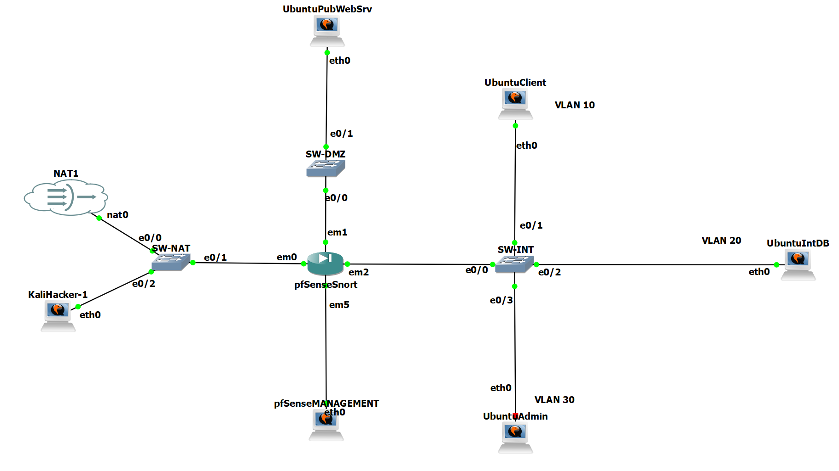
Simulation: Design and Network Topology
Virtualized environment using VMware and GNS3.
Segments with VLANs for Sales, HR, and R&D.
DMZ established for a public-facing server.
VLANs configured on switches to enforce segmentation.

Slide 10
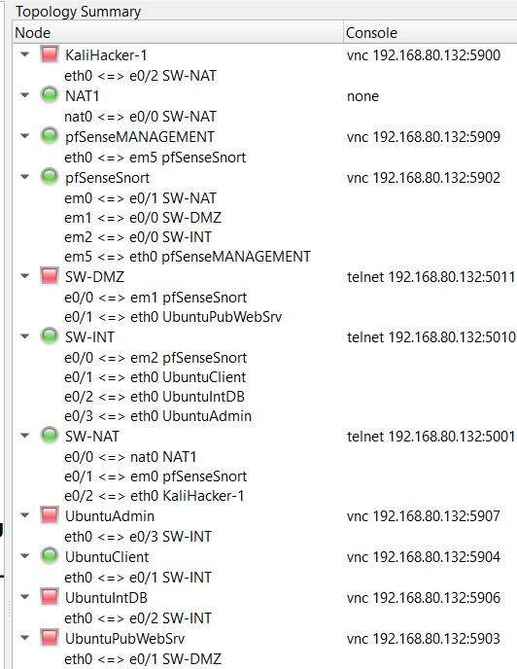
Simulation - Network Segmentation and Firewall
pfSense virtual firewall deployed with interfaces mapped to WAN, LAN, and DMZ.
Firewall rules implemented with access-control lists (ACLs).
Logging enabled on all rules to track violations.
Nmap scans validated exposed ports.

Slide 11
Simulation - IDS/IPS Configuration
Snort installed on a dedicated VM to monitor traffic.
Predefined rule sets enabled to detect threats.
Custom signatures addressed lab-specific concerns.
Alerts tuned to minimize false positives.
Simulated attacks with Metasploit and custom scripts. -
-
-

Slide 12
Simulation - Testing & Security Assessment
Comprehensive penetration tests with Nmap and Metasploit.
Cross-segment attack paths and external threat scenarios explored.Security validation verified firewall and VPN tunnel functionality.
IDS/IPS logs reviewed to ensure accurate capture of malicious activity.
Risk assessment documented vulnerabilities and mitigation strategies. -

Slide 13
Simulation - Findings
Inability to implement identity-based rules with pfSense.
Lack of user authentication protection in the ZTN model.
Explicit firewall rules required for each network segment, increasing complexity.
Omission of a single rule could create vulnerabilities.
Importance of meticulous planning and validation in firewall configuration.

Slide 14
Deployment Considerations
Identity and Access Management (IAM): Implement robust identity verification and access management controls.
Multi-factor authentication (MFA): Ensure that only authorized users gain access to resources.
Micro-Segmentation: Divide the network into smaller, isolated segments.
Continuous Monitoring: Deploy continuous monitoring systems to detect anomalies and threats in real-time.
Explicit Security Policies: Establish clear and explicit security policies for all network traffic.
Data Encryption: Encrypt data both in transit and at rest.
Zero Trust Mindset: Adopt a zero-trust mindset throughout the organization.

Slide 15
Conclusion
ZTA replaces perimeter-based protection with ongoing verification and strict separation.
The simulation showed the advantages and challenges of ZT implementation.
Micro-segmentation, controlled access, and constant monitoring enhanced security.
ZT policies can limit lateral movement and offer solid defense against attacks.
Organizations can improve their security posture with proper planning, configuration, and monitoring.

Slide 16
References
Chuan, T., Lv, Y., Qi, Z., Xie, L., & Guo, W. (2020). An Implementation Method of Zero-trust Architecture. Journal of Physics: Conference Series, 1651(10.1088/1742-6596/1651/1/012010), 012010. https://doi.org/10.1088/1742-6596/1651/1/012010
Lund, B. D., Lee, T.-H., Wang, Z., Wang, T., & Mannuru, N. R. (2024). Zero Trust Cybersecurity: Procedures and Considerations in Context. Encyclopedia, 4(4), 1520–1533. https://doi.org/10.3390/encyclopedia4040099
Mushtaq, S., Mohsin, M., & Mushtaq, M. M. (2025). A Systematic Literature Review on the Implementation and Challenges of Zero Trust Architecture Across Domains. Sensors, 25(19), 6118. https://doi.org/10.3390/s25196118
Reddy, R. P. (2025). Zero Trust Architectures in Modern Enterprises: Principles, Implementation Challenges, and Best Practices. International Journal of Computer Trends and Technology, 73(6), 48–57. https://doi.org/10.14445/22312803/ijctt-v73i6p107
Rose, S., Borchert, O., Mitchell, S., & Connelly, S. (2020). Zero trust architecture. NIST Special Publication 800-207, 1(800-207). https://doi.org/10.6028/nist.sp.800-207
Shaikh, al. (2024). Zero Trust Security Paradigm: A Comprehensive Survey and Research Analysis. Deleted Journal, 19(2), 28–37. https://doi.org/10.52783/jes.688
Yeoh, W., Liu, M., Shore, M., & Jiang, F. (2023). Zero trust cybersecurity: Critical success factors and A maturity assessment framework. Computers & Security, 133(1), 103412. https://doi.org/10.1016/j.cose.2023.103412

